Slide 1
Class Activity
5 students with their opinion on six topics. What can you tell?
P1 [0, -0, 0, 0, 0, 3],
P2 [1, -1, 1, 2, 1, 6],
P3 [2, -2, 4, 4, 0.5, 2],
P4 [3, -3, 9, 6, 0.33, 4],
P5 [4, -4, 16, 8, 0.25, 9]

Slide 2
Dealing with Multidimensional Data using Parallel Coordinates
Debajyoti Mondal
University of Saskatchewan

Slide 3
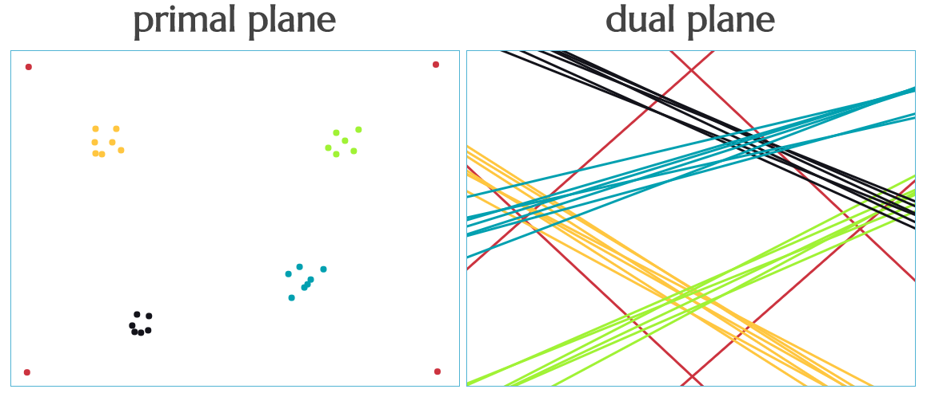
Background Concept: Point-Line Duality
The point-line duality is the
most fundamental concept for parallel coordinates (Inselberg, 1985)
http://students.cec.wustl.edu/~tdeck/duality/

Slide 4
Background Concept: Point-Line Duality
The point-line duality is the
most fundamental concept for parallel coordinates (Inselberg, 1985)
http://students.cec.wustl.edu/~tdeck/duality/

Slide 5
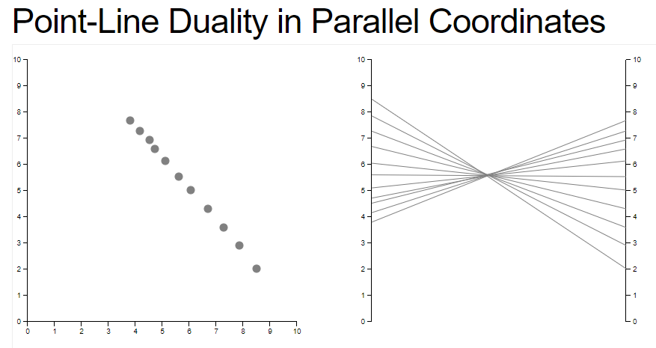
Background Concept: Point-Line Duality

Slide 6
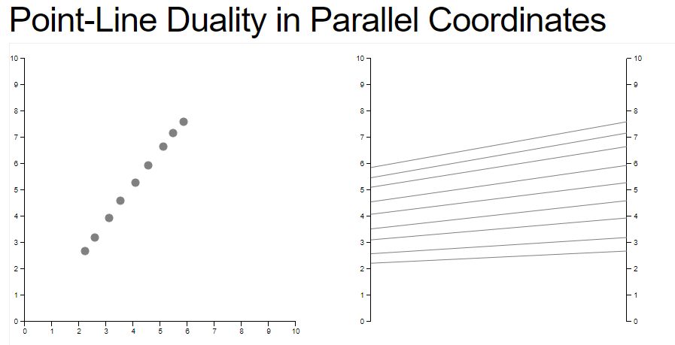
Background Concept: Point-Line Duality

Slide 7
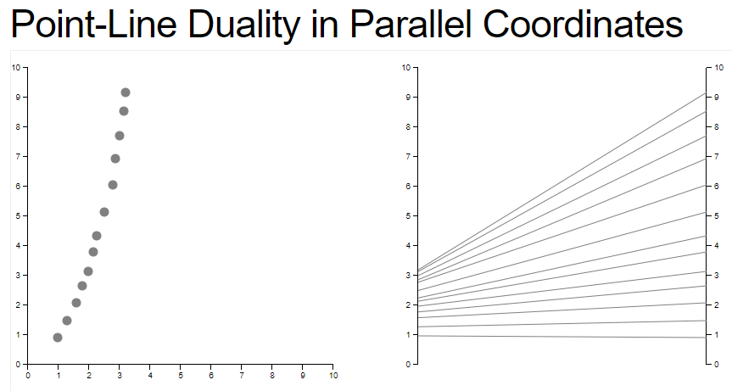
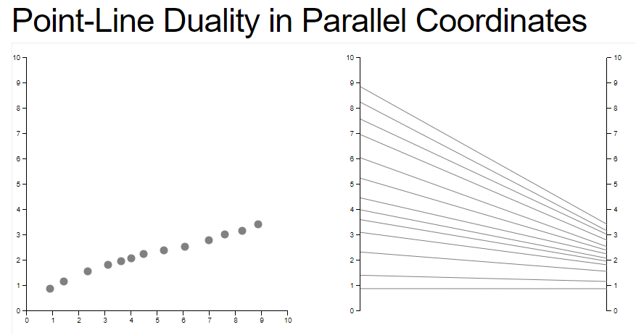
Background Concept: Point-Line Duality

Slide 8
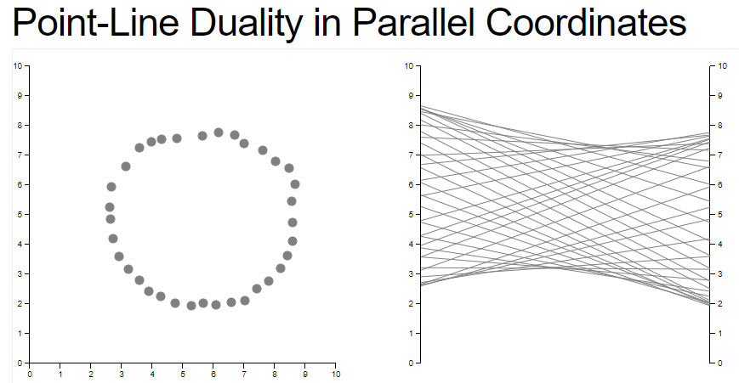
Background Concept: Point-Line Duality

Slide 9
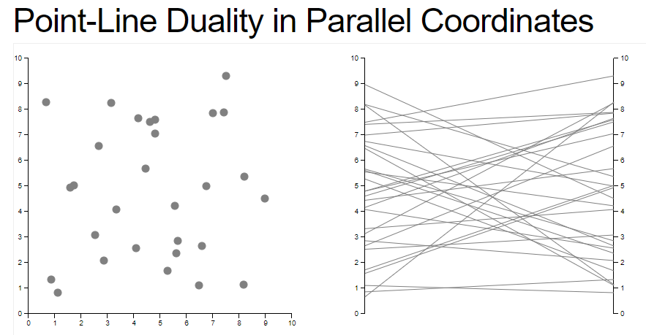
Background Concept: Point-Line Duality

Slide 10
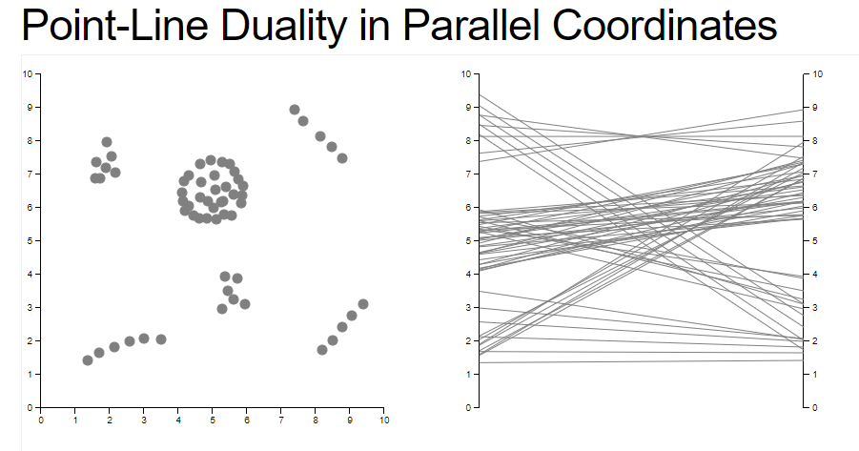
Background Concept: Point-Line Duality
?

Slide 11
Background Concept: Point-Line Duality

Slide 12
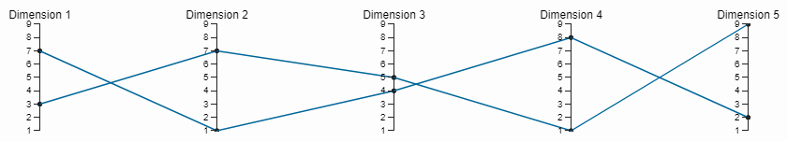
Parallel Coordinates
Fundamental ideas of parallel coordinates:
axes are drawn in parallel.
points are represented by lines.

Slide 13
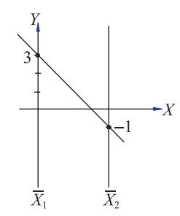
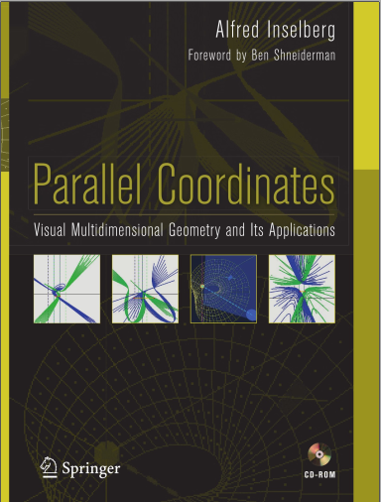
Brief Overview of Another Deep Theory
y = m x + b

Slide 14
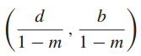
Brief Overview of Another Deep Theory
X₂
X₁
y = -x + 3
m = -1
b = 3

Slide 15
Brief Overview of Another Deep Theory
X₂
d = 4
(2, 1.5)
X₁
y = -x + 3
m = -1
b = 3

Slide 16
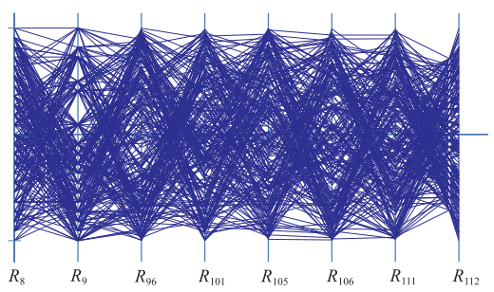
Parallel Coordinates: Industry Example

Slide 17
Top Hat Q3.3: Can Parallel Coordinate Handle BigData?
Lots of data→ lots of lines →nothing visible
Dimensions are parallel → never run out of space!
Pattern – if visible – is only between the adjacent dimensions
All the above are true

Slide 18
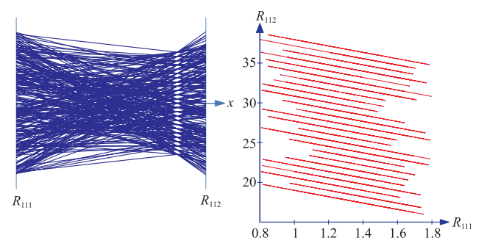
Parallel Coordinates: Industry Example

Slide 19
Parallel Coordinates: Industry Example
Is there a missing parameter?

Slide 20
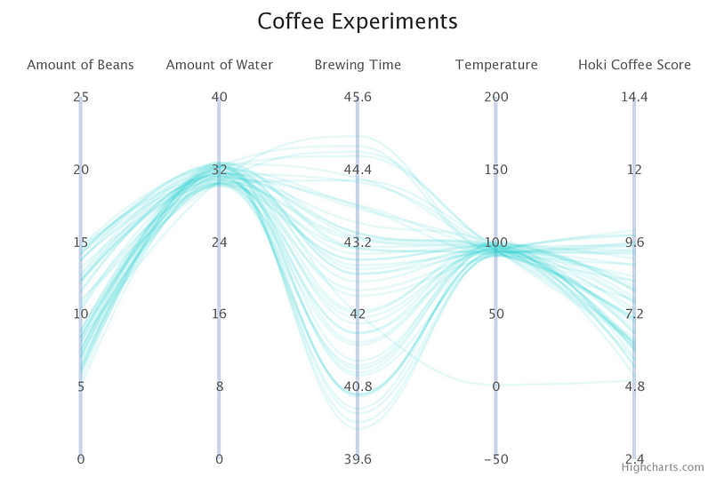
Class Activity:
(Synthetic Data)
Can you find any useful information from this plot?
If so, please write it down.
If not, how could you improve the plot?
Notes:
https://medium.com/@hokifung_/data-storytelling-making-sense-of-complex-multi-dimensional-data-with-parallel-coordinates-plots-e73ddb1eb7f4

Slide 21
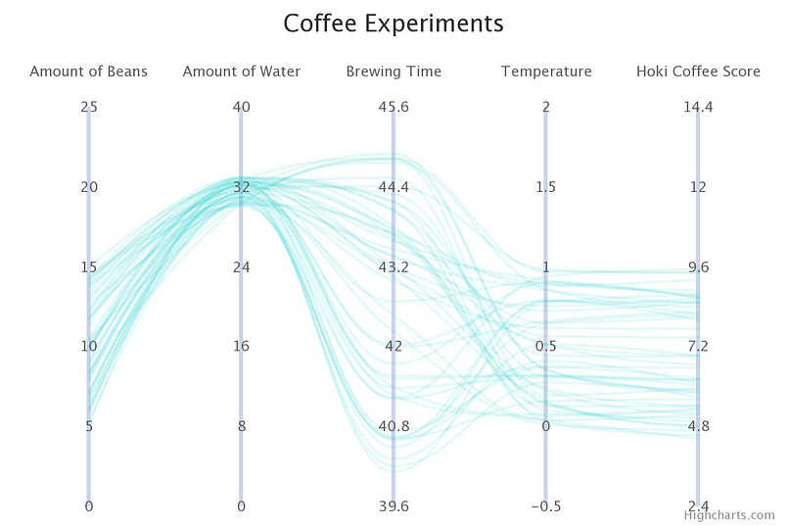
Scale Matters
(Synthetic Data)
(Synthetic Data)
Notes:
https://medium.com/@hokifung_/data-storytelling-making-sense-of-complex-multi-dimensional-data-with-parallel-coordinates-plots-e73ddb1eb7f4

Slide 22
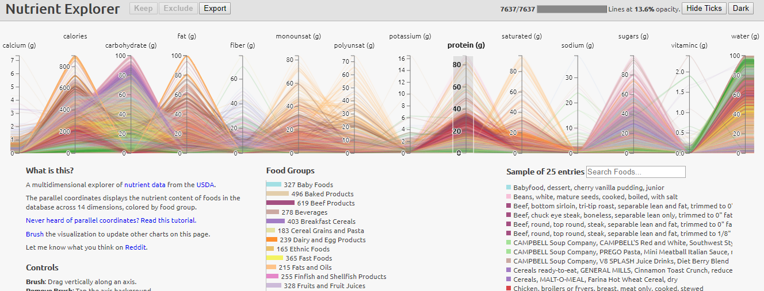
Interaction: Brushing & Sliding
https://gist.github.com/syntagmatic/c9fb69e425a3c07cfbd09169941fbf46

Slide 23
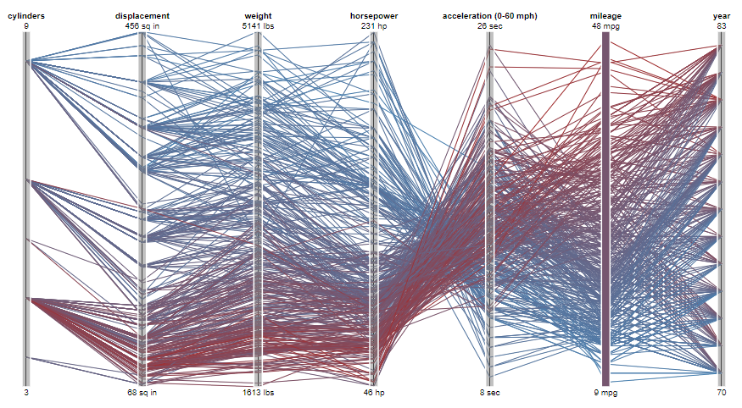
Interaction: Brushing & Sliding
http://mbostock.github.io/protovis/ex/cars.html

Slide 24
Limitations
Lots of over-plotting can make it impossible to read
Number of dimensions on screen also needs to be below about a dozen
A few thousand records.
The data needs to be numerical.

Slide 25
Example: Nutrient Explorer
https://gist.github.com/syntagmatic/c9fb69e425a3c07cfbd09169941fbf46

Slide 26
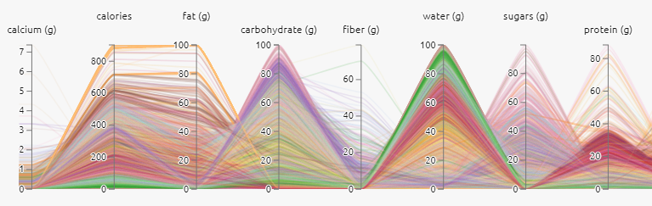
Example: Nutrient Explorer
https://gist.github.com/syntagmatic/c9fb69e425a3c07cfbd09169941fbf46

Slide 27
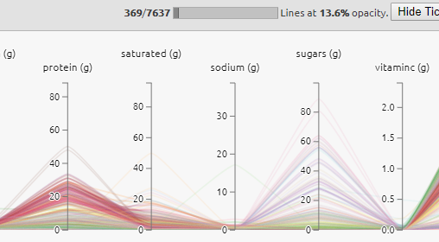
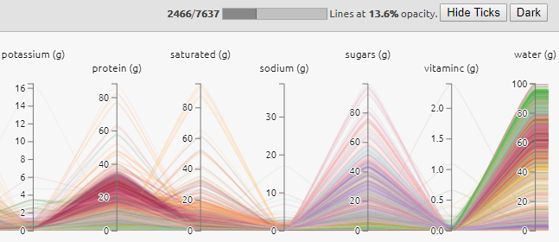
Progressive Rendering
Gives the user value
Overkill if the dataset is small

Slide 28
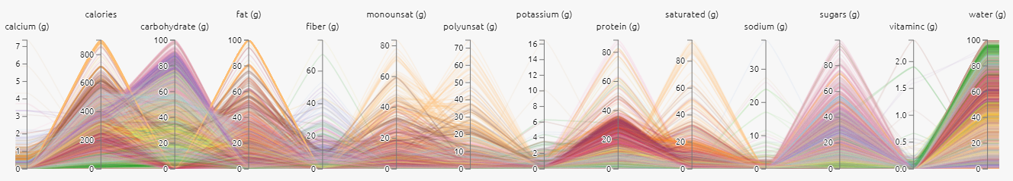
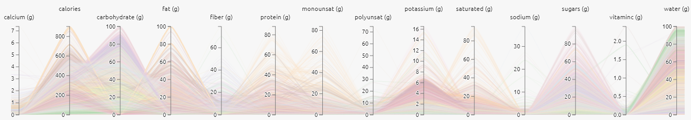
Interaction: Dragging Dimensions
Very Useful for Analyzing pairs of parameters

Slide 29
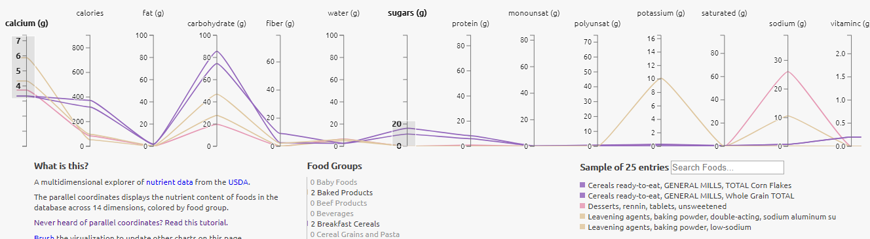
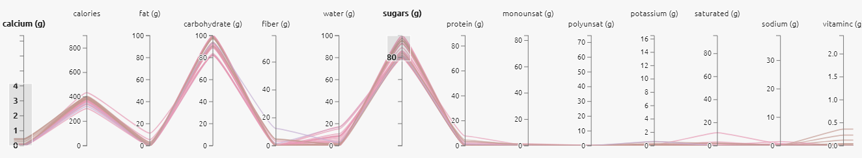
Interaction: Brushing & Sliding

Slide 30
Interaction: Brushing & Sliding
http://mbostock.github.io/protovis/ex/cars.html

Slide 31
Curve vs Straight-Line Which one you like? Why?

Slide 32
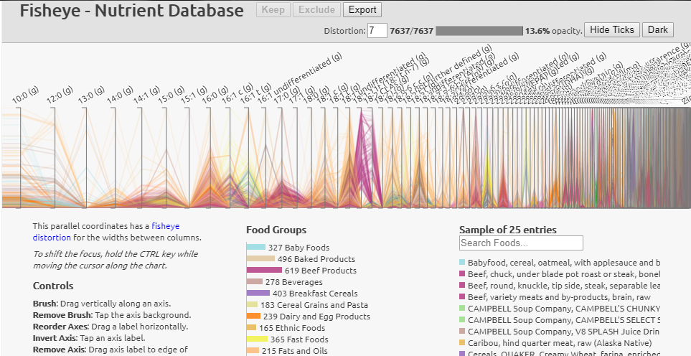
Fisheye Interaction

Slide 33
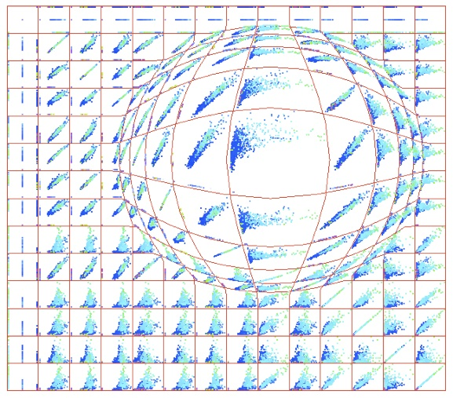
Fisheye Interaction

Slide 34
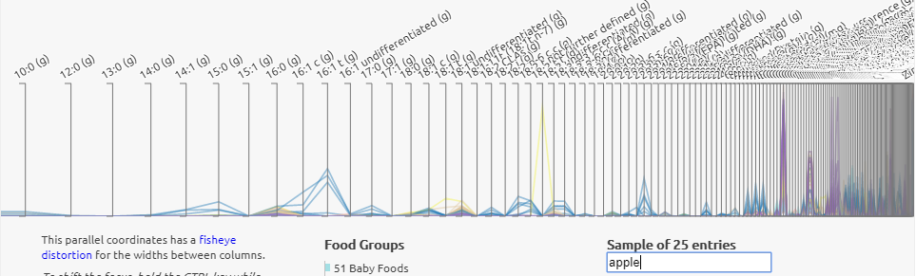
Fisheye Interaction

Slide 35
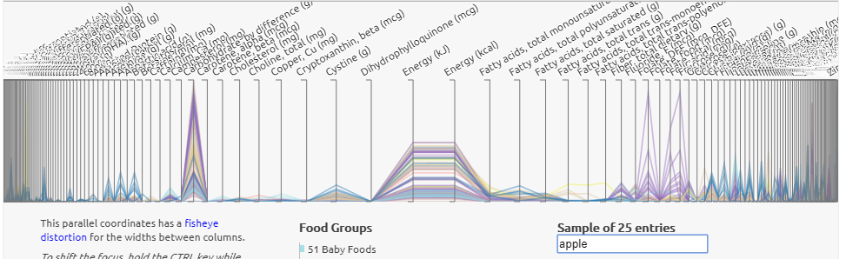
Fisheye Interaction

Slide 36
Limitations
Lots of over-plotting can make it impossible to read
Number of dimensions on screen also needs to be below about a dozen
A few thousand records.
The data needs to be numerical.

